Slide 1
Project 1- Supermart Grocery Sales Analysis

Slide 2
Problem Statement: To analyze and model grocery sales data from a supermarket to uncover patterns, identify key factors influencing sales and profit,using different charts and visualization tools .Provide insights and suggestions after analysis.

Slide 3
Key Objectives:
Exploratory Data Analysis:
Explore the dataset to understand sales trends, regional performance, and customer preferences.
Identify patterns in sales and profit across different categories, subcategories, and time periods.
Finding Insights:
Highlight the impact of key factors like discount, category, and region on sales and profit.
Provide actionable recommendations for optimizing marketing strategies, inventory management, and pricing.

Slide 4
Supermarket Sales Data Analysis
#import required libraries import pandas as pd import numpy as np
import seaborn as sns
import matplotlib.pyplot as plt
df=pd.read_csv('Supermart Grocery Sales - Retail Analytics Dataset (1).csv')
df.head()
Order ID Customer Name Category Sub Category
0 OD1 Harish Oil & Masala Masalas
City \
1 OD2 Sudha Beverages Health Drinks
Vellore
2 OD3 Hussain Food Grains Atta & Flour
Krishnagiri
Perambalur
3 OD4 Jackson Fruits & Veggies Fresh Vegetables
4 OD5 Ridhesh Food Grains Organic Staples Ooty
Order Date | Region | Sales | Discount | Profit | State
0 11-08-2017 | North | 1254 | 0.12 | 401.28 | Tamil Nadu
1 11-08-2017 | South | 749 | 0.18 | 149.80 | Tamil Nadu
2 06-12-2017 | West | 2360 | 0.21 | 165.20 | Tamil Nadu
3 10-11-2016 | South | 896 | 0.25 | 89.60 | Tamil Nadu
4 10-11-2016 | South | 2355 | 0.26 | 918.45 | Tamil Nadu
df.shape
(9994, 11)
df.info()
<class 'pandas.core.frame.DataFrame'>
RangeIndex: 9994 entries, 0 to 9993
Data columns (total 11 columns):
# | Column Non-Null Count |  |  | Dtype
Order ID 9994 non-null object
Customer Name 9994 non-null object
Category 9994 non-null object
Sub Category 9994 non-null object
City 9994 non-null object

Slide 5
Order Date
Region
9994 non-null
9994 non-null
object object
7 Sales
9994 non-null int64
Discount
Profit
9994 non-null float64
9994 non-null float64
10 State 9994 non-null object
dtypes: float64(2), int64(1), object(8)
memory usage: 859.0+ KB
df.describe()
 | Sales | Discount | Profit
count | 9994.000000 | 9994.000000 | 9994.000000
mean | 1496.596158 | 0.226817 | 374.937082
std | 577.559036 | 0.074636 | 239.932881
min | 500.000000 | 0.100000 | 25.250000
25% | 1000.000000 | 0.160000 | 180.022500
50% | 1498.000000 | 0.230000 | 320.780000
75% | 1994.750000 | 0.290000 | 525.627500
max | 2500.000000 | 0.350000 | 1120.950000
df.isnull().sum()
0
0
0
0
0
0
0
0
0
0
0
Order ID Customer Name Category
Sub Category City
Order Date Region Sales Discount Profit State
dtype: int64
df.duplicated()
0
1
2
3
4
False
False
False
False
False
...
9989 False
9990 False
9991 False
9992 False
9993 False
Length: 9994, dtype: bool

Slide 6
df.drop_duplicates(inplace=True)
df.dropna()
Order ID |  | Customer Name | Category | Sub Category
City \
0 OD1 |  | Harish | Oil & Masala | Masalas
Vellore
1 OD2 |  | Sudha | Beverages | Health Drinks
Krishnagiri
2 | OD3 | Hussain | Food Grains | Atta & Flour
Perambalur
3 | OD4 | Jackson | Fruits & Veggies | Fresh Vegetables
Dharmapuri
4 OD5
Ridhesh
Food Grains
Organic Staples
Ooty
... ...
...
...
...
...
9989 OD9990
Sudeep
Eggs, Meat & Fish
Eggs
Madurai
9990 OD9991
Alan
Bakery
Biscuits
Kanyakumari
9991 OD9992
Ravi
Food Grains
Rice
Bodi
9992 OD9993
Peer
Oil & Masala
Spices
Pudukottai
9993 OD9994
Ganesh
Food Grains
Atta & Flour
Tirunelveli
 | Order Date | Region | Sales | Discount | Profit | State
0 | 11-08-2017 | North | 1254 | 0.12 | 401.28 | Tamil Nadu
1 | 11-08-2017 | South | 749 | 0.18 | 149.80 | Tamil Nadu
2 | 06-12-2017 | West | 2360 | 0.21 | 165.20 | Tamil Nadu
3 | 10-11-2016 | South | 896 | 0.25 | 89.60 | Tamil Nadu
4 | 10-11-2016 | South | 2355 | 0.26 | 918.45 | Tamil Nadu
... | ... | ... | ... | ... | ... | ...
9989 | 12/24/2015 | West | 945 | 0.16 | 359.10 | Tamil Nadu
9990 | 07-12-2015 | West | 1195 | 0.26 | 71.70 | Tamil Nadu
9991 | 06-06-2017 | West | 1567 | 0.16 | 501.44 | Tamil Nadu
9992 | 10/16/2018 | West | 1659 | 0.15 | 597.24 | Tamil Nadu
9993 | 4/17/2018 | West | 1034 | 0.28 | 165.44 | Tamil Nadu
[9994 rows x 11 columns]
df['Order Date']=pd.to_datetime(df['Order Date'],infer_datetime_format=True, errors='coerce')

Slide 7
df.info()
<class 'pandas.core.frame.DataFrame'>
RangeIndex: 9994 entries, 0 to 9993
Data columns (total 11 columns):
# Column Non-Null Count Dtype
Order ID 9994 non-null object
Customer Name 9994 non-null object
Category 9994 non-null object
Sub Category 9994 non-null object
City 9994 non-null object
Order Date 4042 non-null datetime64[ns]
Region 9994 non-null object
Sales 9994 non-null int64
Discount
Profit
9994 non-null float64
9994 non-null float64
10 State 9994 non-null object
dtypes: datetime64[ns](1), float64(2), int64(1), object(7)
memory usage: 859.0+ KB
df.head()
Order ID Customer Name Category Sub Category
City \
0 | OD1 |  | Harish | Oil & Masala | Masalas
Vellore
1 | OD2 |  | Sudha | Beverages | Health Drinks
Krishnagiri OD3 Hussain Food Grains Atta & Flour Perambalur OD4 Jackson Fruits & Veggies Fresh Vegetables Dharmapuri OD5 Ridhesh Food Grains Organic Staples
Ooty
Order Date | Region | Sales | Discount | Profit | State
0 2017-11-08 | North | 1254 | 0.12 | 401.28 | Tamil Nadu
1 2017-11-08 | South | 749 | 0.18 | 149.80 | Tamil Nadu
2 2017-06-12 | West | 2360 | 0.21 | 165.20 | Tamil Nadu
3 2016-10-11 | South | 896 | 0.25 | 89.60 | Tamil Nadu
4 2016-10-11 | South | 2355 | 0.26 | 918.45 | Tamil Nadu

Slide 8
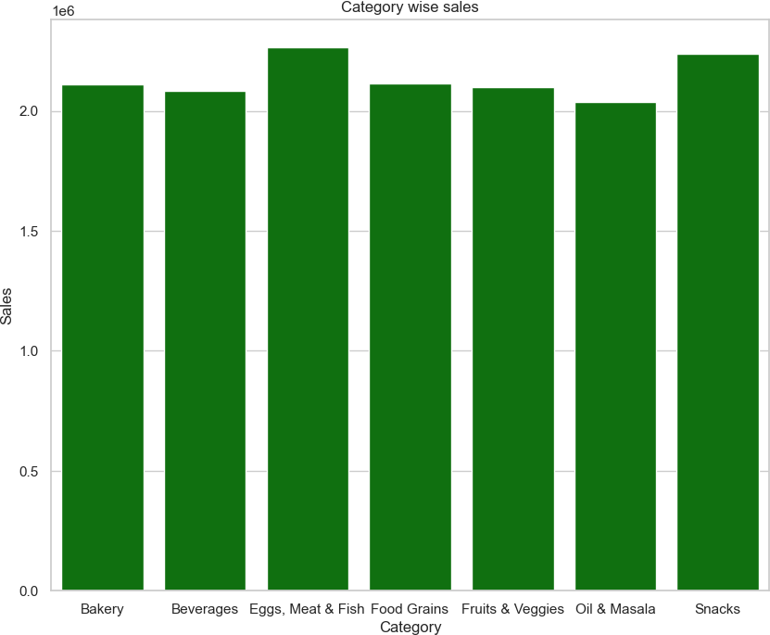
Category wise sales
category_sales=df.groupby(['Category'])['Sales'].sum().reset_index() category_sales.sort_values(by='Sales')
plt.figure(figsize=(10,8)) sns.barplot(data=category_sales,x='Category',y='Sales',color='green')
plt.xlabel('Category')
plt.ylabel('Sales') plt.title('Category wise sales')
plt.show()
Observations:
1.Eggs,meat and fish category has the highest sales over all categories.
2.Oil and Masala has lowest sales among all categories

Slide 9
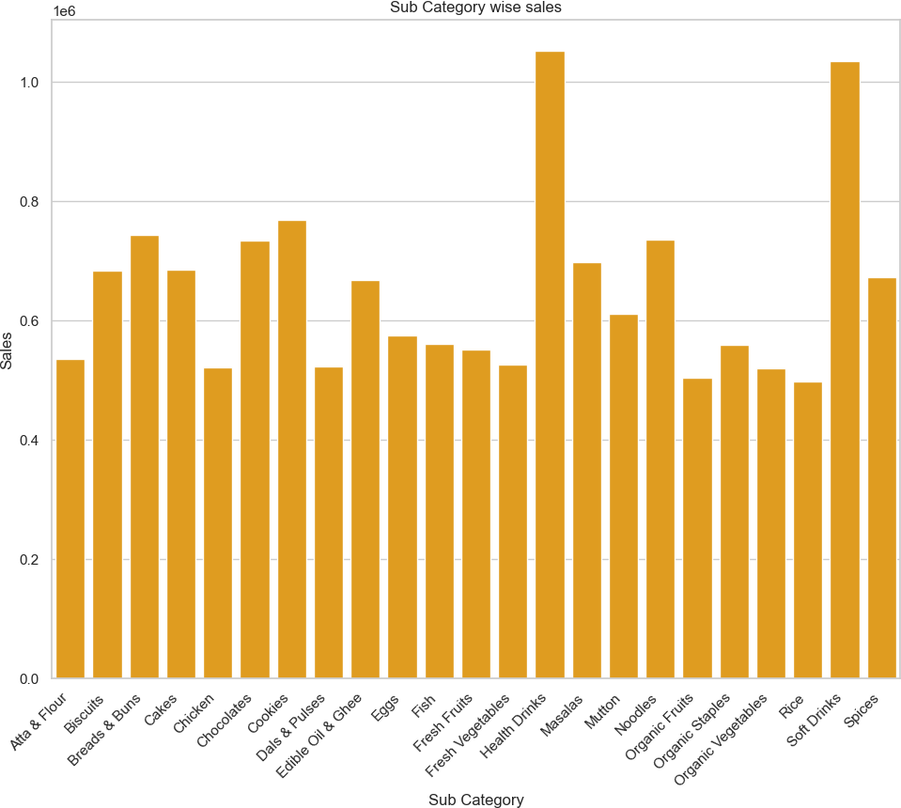
Sales by Sub-Category
Sub_category_sales=df.groupby(['Sub Category']) ['Sales'].sum().reset_index() Sub_category_sales.sort_values(by='Sales') plt.figure(figsize=(10,8)) sns.barplot(data=Sub_category_sales,x='Sub Category',y='Sales',color='orange') plt.tight_layout()
plt.xlabel('Sub Category') plt.ylabel('Sales')
plt.title('Sub Category wise sales') plt.xticks(rotation=45, ha='right')
plt.show()

Slide 10
Observations:
Health Drinks and Soft Drinks has the highest number of total sales in the entire sub category.
While, Rice and Organic Fruits has the lowest number of total sales in the entire sub category.
Region wise sales
region_sales = df.groupby(['Region'])['Sales'].sum() plt.figure(figsize=(10, 6))
plt.pie(region_sales, labels=region_sales.index, autopct='%1.1f%%’,
startangle=140, colors=plt.cm.Paired.colors) plt.title('Region-wise Sales', fontsize=14) plt.axis('equal')
plt.tight_layout()
plt.show()

Slide 11
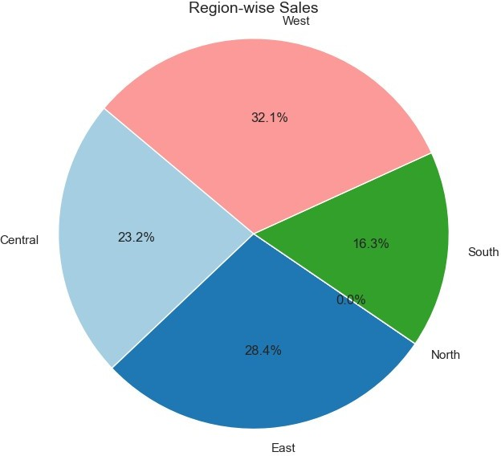
Observations:
West region has most(32.1%) sales as compared to all regions,Then east(28.4%) region followed by central region.
However North is not included in the chart as it has only one record in the dataset.

Slide 12
Line Plot of Sales and Profit -
#df['Order Month'] = df['Order Date'].dt.month
df['Order Month Name'] = df['Order Date'].dt.month_name()
month_order = [
"January", "February", "March", "April", "May", "June",
"July", "August", "September", "October", "November", "December"]
# Convert 'Order Month Name' into a categorical variable with the correct order
df['Order Month Name'] = pd.Categorical(df['Order Month Name'], categories=month_order, ordered=True)
# Sort the DataFrame by the ordered 'Order Month Name' column
df = df.sort_values(by='Order Month Name') # Set Seaborn theme sns.set_theme(style="whitegrid")
# Create figure and axes
plt.figure(figsize=(10, 6))
# Line plot for Sales vs. Discount
sns.lineplot(data=df, x='Order Month Name', y='Sales', color='blue', label='Sales ', marker='o', linewidth=2)
# Line plot for Profit vs. Discount sns.lineplot(data=df, x='Order Month Name', y='Profit', color='orange', label='Profit', marker='s', linewidth=2)
# Add title and labels
plt.title('Line Plot of Sales and Profit ', fontsize=16) plt.xlabel('Date', fontsize=12)
plt.ylabel('Value', fontsize=12)
# Add legend
plt.legend(title='Legend', fontsize=10)
# Show plot
plt.tight_layout()
plt.show()

Slide 13
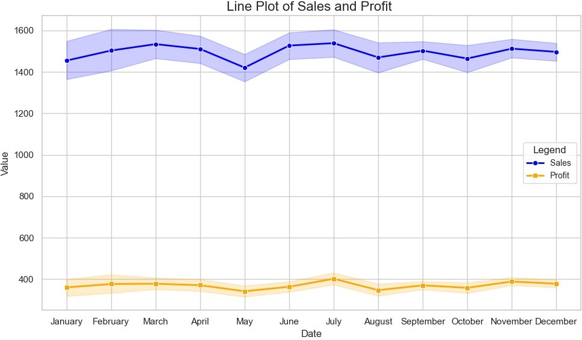
Sales by Year-
df['year'] = df['Order Date'].dt.year Yearly_Sales=df.groupby('year')['Sales'].sum()
year_labels = Yearly_Sales.index.astype(int) plt.pie(Yearly_Sales, labels=year_labels, autopct='%1.1f%%') plt.title('Sales by Year')
plt.show()

Slide 14
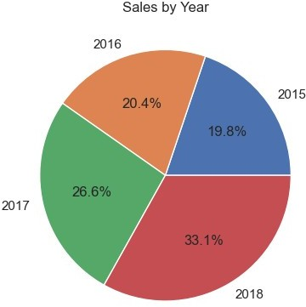
Observations-
1.Year 2018 shows highest Sales amongst all years. 2.2015 shows less sales compared to all years.
Profit by Year-
df['year'] = df['Order Date'].dt.year Yearly_Profit=df.groupby('year')['Profit'].sum()
year_labels = Yearly_Sales.index.astype(int) plt.pie(Yearly_Profit, labels=year_labels, autopct='%1.2f%%') plt.title('Profit by Year')
plt.show()

Slide 15

Observations-
1.Year 2018 shows highest profit amongst all years. 2.2015 shows less profit compared to all years.
Total Sales Over the Years by Region-
df['year']=df['Order Date'].dt.year
# Group sales by year and region
yearly_sales = df.groupby(['year', 'Region']) ['Sales'].sum(numeric_only=True).reset_index()
# Ensure year is a string for plotting yearly_sales['year'] = yearly_sales['year'].astype(str) #year_labels = yearly_sales.index.astype(int)
# Set Seaborn theme
sns.set_theme(style="whitegrid")
# Create figure
plt.figure(figsize=(10, 6))
# Line plot with Seaborn
sns.lineplot(data=yearly_sales, x='year',y='Sales',hue='Region',marker='o',linewidth=2,palette='tab10'
)
# Add title and labels

Slide 16
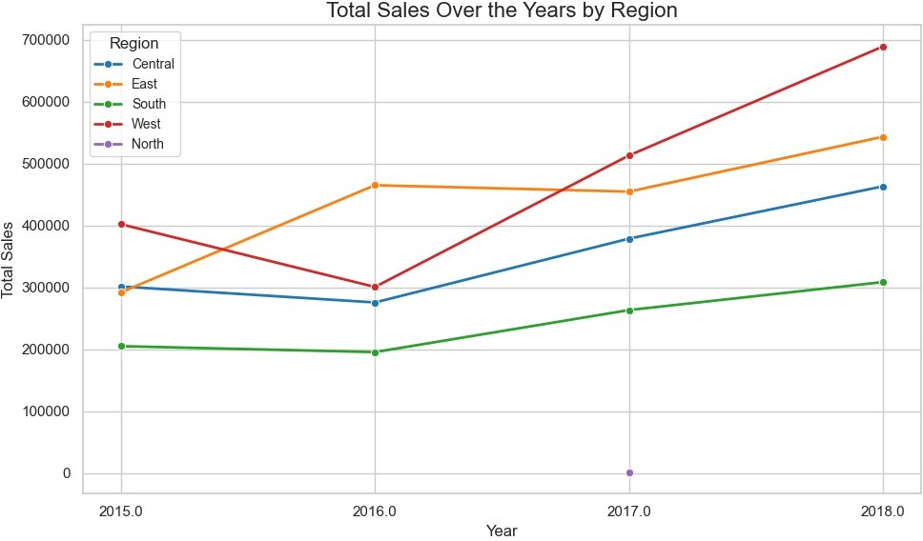
plt.title('Total Sales Over the Years by Region', fontsize=16) plt.xlabel('Year', fontsize=12)
plt.ylabel('Total Sales', fontsize=12)
# Adjust legend
plt.legend(title='Region', fontsize=10, loc='upper left')
# Show the plot plt.tight_layout() plt.show()
Observation:
In all regions there has been steady increase in sales over the years.
Sales and Profit over Regions
#Create pivot table for sales and profit
salesprofit = df.pivot_table(index='Region', values=['Sales', 'Profit'], aggfunc='sum').reset_index()
# Calculate average sales and profit
averagesales = df.groupby('Region')['Sales'].sum().mean() averageprofit = df.groupby('Region')['Profit'].sum().mean() print(averagesales)
print(averageprofit) print(salesprofit)
# Set the figure size

Slide 17
plt.figure(figsize=(10, 6))
# Create a stacked bar chart regions = salesprofit['Region'] sales = salesprofit['Sales'] profit = salesprofit['Profit']
plt.bar(regions, sales, label='Sales', color='blue')
plt.bar(regions, profit, bottom=sales, label='Profit', color='orange')
# Add horizontal lines for average sales and profit plt.axhline(y=averagesales, color='black', linestyle='--',label='Average Sales')
plt.axhline(y=averageprofit + averagesales, color='gray', linestyle='--', label='Average Profit')
# Customize the chart
plt.title('Sales and Profit over Regions', fontsize=16) plt.xlabel('Region', fontsize=12)
plt.ylabel('Value', fontsize=12) plt.legend(title='Legend', fontsize=10, loc='upper left')
# Display the chart
plt.tight_layout()
plt.show()
2991396.4
749424.24
Region
Central
East
North
South
West
Profit Sales 856806.84 3468156
1074345.58 4248368
401.28
623562.89 2440461
1192004.61 4798743
Sales
1254

Slide 18
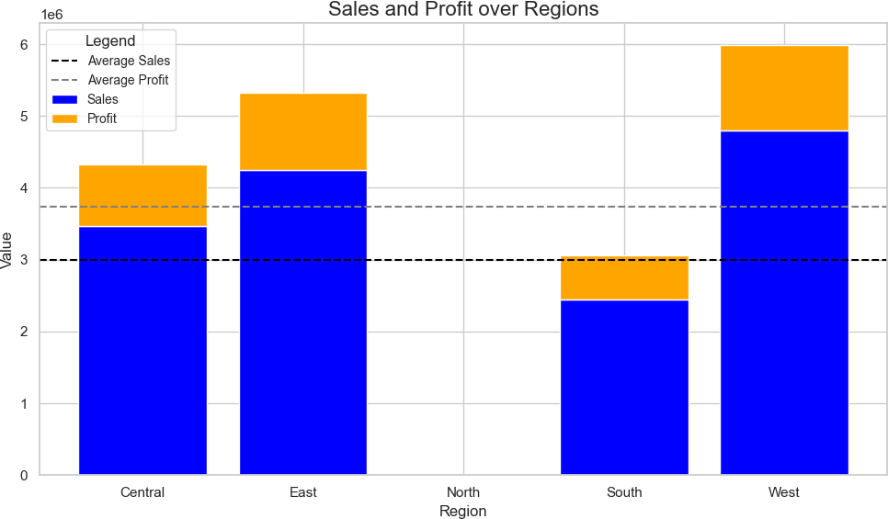
Observations:
Average sales amount is 3738932
Average profit amount is 936679.98
All regions except South has crossed the average sales and profit mark

Slide 19
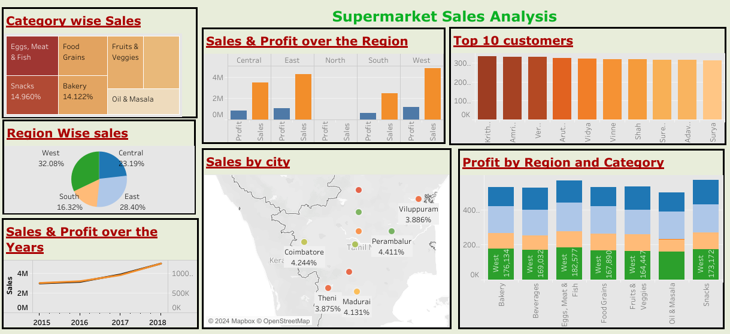
Dashboard

Slide 20
Insights -
The Eggs, Meat, and Fish category is the top-performing category, indicating a high demand and consistent consumer preference for these products.
Oil and Masala has the lowest sales, suggesting either a niche demand or underperformance in this segment, potentially due to competition or pricing.
Health Drinks and Soft Drinks dominate the sub-category sales, highlighting their popularity and potential for growth in the beverage market.
On the other hand, Rice and Organic Fruits exhibit the lowest sales, signaling a need to revisit marketing, availability, or pricing strategies for these sub-catego.
The West region leads in sales, accounting for 32.1% of the total,Closely followed by the East region with 28.4%. These regions can be targeted for further expansion and promotional activities.
4.The Central region performs moderately, while the North region is underrepresented, having only one record in the dataset. Further data collection and analysis for the North region could provide better insights.
5.2018 stands out with the highest sales, indicating a peak in business performance during that year, possibly due to market trends or strategic initiatives.
2015 shows the lowest sales, warranting a deeper analysis of factors contributing to this underperformance.
Similar to sales, 2018 records the highest profit, showcasing effective cost management or pricing strategies.
2015 has the lowest profit, reinforcing the need to analyze and address the underlying causes.
Across all regions, there has been a steady increase in sales over the years, reflecting a positive growth trajectory. This trend indicates increasing market penetration and consumer acceptance.
The average sales amount is 3,738,932, while the average profit is 936,679.98.
Regions such as West, East, and Central have surpassed these averages, demonstrating their strong market performance.
The South region lags behind, providing an opportunity to explore new strategies to enhance its sales and profitability.

Slide 21
Recommendations –
1. Continue to invest in this high-performing category Eggs, Meat, and Fish by ensuring consistent supply, competitive pricing, and targeted promotions to sustain the demand .Investigate the reasons behind the low sales, such as potential pricing issues, product competition, or limited consumer interest. Consider niche marketing campaigns or improving product positioning to boost visibility and demand.
2.Build on the strong performance in East & West regions with promotional campaigns and customer loyalty programs. Consider introducing region-specific product variants to drive further growth.
3.Since the North region is underrepresented, conduct more robust data collection and market research to explore potential opportunities and address gaps 4.To find reason of underperforming year (2015),Analyze the strategies or external factors that contributed to the success in 2018 and replicate these learnings in current and future operations.
5.Conduct a root cause analysis of the low sales and profits in 2015 to identify and rectify systemic issues or challenges that may persist.
6.The steady increase in sales across all regions indicates a positive growth. Strengthen this growth by enhancing customer experiences, and introducing innovative products.
7.Improve data collection methods for the North region to obtain a comprehensive understanding of its market dynamics. Implement predictive analytics to anticipate trends and align strategies accordingly.

Slide 22
Project 2 Netflix Data: Cleaning, Analysis and Visualization

Slide 23
Introduction- This project involves loading, cleaning, analyzing, and visualizing data from a Netflix dataset. We'll use Python libraries like Pandas, Matplotlib, and Seaborn to work through the project. The goal is to explore the dataset, derive insights, and provide recommendations according to analysis.

Slide 24
Netflix Data Analysis
# import required libraries
import numpy as np import pandas as pd import seaborn as sns
import matplotlib.pyplot as plt
DF = pd.read_csv('netflix1.csv')
DF.shape
(8790, 10)
DF.head()
 | show_id | type | title | director
\
0 | s1 | Movie | Dick Johnson Is Dead | Kirsten Johnson
1 | s3 | TV Show |  | Ganglands | Julien Leclercq
2 | s6 | TV Show |  | Midnight Mass | Mike Flanagan
3 | s14 | Movie | Confessions of | an Invisible Girl | Bruno Garotti
4 | s8 | Movie |  | Sankofa | Haile Gerima
 | country date_added | release_year rating | duration | \
0 | United States 9/25/2021 | 2020 PG-13 | 90 min
1 | France 9/24/2021 | 2021 TV-MA | 1 Season
2 | United States 9/24/2021 | 2021 TV-MA | 1 Season
3 | Brazil 9/22/2021 | 2021 TV-PG | 91 min
4 | United States 9/24/2021 | 1993 TV-MA | 125 min
listed_in
Documentaries
Crime TV Shows, International TV Shows, TV Act...
TV Dramas, TV Horror, TV Mysteries
Children & Family Movies, Comedies
Dramas, Independent Movies, International Movies
DF.tail()
show_id | type | title | director | country \
8785 s8797 | TV Show | Yunus Emre | Not Given | Turkey
8786 s8798 | TV Show | Zak Storm | Not Given | United States
8787 s8801 | TV Show | Zindagi Gulzar Hai | Not Given | Pakistan

Slide 25
 | 8788 | s8784 | TV | Show | Yoko | Not Given | Pakistan
 | 8789 | s8786 | TV | Show | YOM | Not Given | Pakistan
 | date_added | release_year | rating | duration | \
8785 | 1/17/2017 | 2016 | TV-PG | 2 Seasons
8786 | 9/13/2018 | 2016 | TV-Y7 | 3 Seasons
8787 | 12/15/2016 | 2012 | TV-PG | 1 Season
8788 | 6/23/2018 | 2016 | TV-Y | 1 Season
8789 | 06-07-2018 | 2016 | TV-Y7 | 1 Season
listed_in
8785 International TV Shows, TV Dramas
8786 Kids' TV
8787 International TV Shows, Romantic TV Shows, TV ... 8788 Kids' TV
8789 Kids' TV
DF.describe()
 | release_year
count | 8790.000000
mean | 2014.183163
std | 8.825466
min | 1925.000000
25% | 2013.000000
50% | 2017.000000
75% | 2019.000000
max | 2021.000000
DF.info()
<class 'pandas.core.frame.DataFrame'>
RangeIndex: 8790 entries, 0 to 8789
Data columns (total 10 columns):
# Column Non-Null Count Dtype
show_id
type
title
director
country
date_added
8790 non-null object
8790 non-null object
8790 non-null object
8790 non-null object
8790 non-null object
8790 non-null object
6 release_year 8790 non-null int64
rating
duration
listed_in
8790 non-null object
8790 non-null object
8790 non-null object
dtypes: int64(1), object(9)
memory usage: 686.8+ KB
DF.isnull().sum()

Slide 26
show_id type title director country
date_added release_year rating duration listed_in dtype: int64
0
0
0
0
0
0
0
0
0
0
DF.drop_duplicates(inplace=True)
DF.dropna()
show_id type director \
title
0
Johnson 1
Leclercq 2
Flanagan 3
Garotti 4
Gerima
...
s1 Movie
Dick Johnson Is Dead
Kirsten
s3 TV Show
s6 TV Show s14 Movie
s8 Movie
... ...
Ganglands
Julien
Midnight Mass
Mike
Confessions of an Invisible Girl
Bruno
Sankofa
Haile
..
8785 s8797 TV Show
Given
8786 s8798 TV Show
Given
8787 s8801 TV Show
Given
8788 s8784 TV Show
Given
8789 s8786 TV Show
Given
...
.
Yunus Emre
Not
Zak Storm
Not
Zindagi Gulzar Hai
Not
Yoko
Not
YOM
Not
 | country | date_added | release_year | rating | duration | \
0 | United States | 9/25/2021 | 2020 | PG-13 | 90 min
1 | France | 9/24/2021 | 2021 | TV-MA | 1 Season
2 | United States | 9/24/2021 | 2021 | TV-MA | 1 Season
3 | Brazil | 9/22/2021 | 2021 | TV-PG | 91 min
4 | United States | 9/24/2021 | 1993 | TV-MA | 125 min
... | ... | ... | ... | ... | ...
8785 | Turkey | 1/17/2017 | 2016 | TV-PG | 2 Seasons

Slide 27
 | 8786 | United States | 9/13/2018 | 2016 TV-Y7 | 3 Seasons
 | 8787 | Pakistan | 12/15/2016 | 2012 TV-PG | 1 Season
 | 8788 | Pakistan | 6/23/2018 | 2016 TV-Y | 1 Season
 | 8789 | Pakistan | 06-07-2018 | 2016 TV-Y7 | 1 Season
listed_in
Documentaries
Crime TV Shows, International TV Shows, TV Act...
TV Dramas, TV Horror, TV Mysteries
Children & Family Movies, Comedies
Dramas, Independent Movies, International Movies
... ...
8785 International TV Shows, TV Dramas
8786 Kids' TV
8787 International TV Shows, Romantic TV Shows, TV ... 8788 Kids' TV
8789 Kids' TV
[8790 rows x 10 columns]
DF['date_added'] = pd.to_datetime(DF['date_added'], infer_datetime_format=True, errors='coerce')
DF['date_added'] = pd.to_datetime(DF['date_added'],
infer_datetime_format=True, errors='coerce')
DF.dtypes
show_id type title director country
date_added release_year rating duration listed_in
object object object object object
datetime64[ns]
int64 object object object
dtype: object
DF.head()
 | show_id | type | title | director
\
0 | s1 | Movie | Dick Johnson Is Dead | Kirsten Johnson

Slide 28
1 | s3 | TV Show | Ganglands | Julien Leclercq
2 | s6 | TV Show | Midnight Mass | Mike Flanagan
3 | s14 | Movie | Confessions of an Invisible Girl | Bruno Garotti
4 | s8 | Movie | Sankofa | Haile Gerima
 | country date_added | release_year rating | duration | \
0 | United States 2021-09-25 | 2020 PG-13 | 90 min
1 | France 2021-09-24 | 2021 TV-MA | 1 Season
2 | United States 2021-09-24 | 2021 TV-MA | 1 Season
3 | Brazil 2021-09-22 | 2021 TV-PG | 91 min
4 | United States 2021-09-24 | 1993 TV-MA | 125 min
listed_in
Documentaries
Crime TV Shows, International TV Shows, TV Act...
TV Dramas, TV Horror, TV Mysteries
Children & Family Movies, Comedies
Dramas, Independent Movies, International Movies
Distribution of content by type -
# Count the number of Movies and TV Shows
type_counts = DF['type'].value_counts()
# Create the figure and axes
fig, axes = plt.subplots(1, 2, figsize=(12, 6)) colors = sns.color_palette("muted", len(type_counts)) # Plot a countplot
sns.countplot(data=DF, x='type', ax=axes[0], palette="pastel") axes[0].set_title('Count of Content by Type', fontsize=14) axes[0].set_xlabel('Type', fontsize=12) axes[0].set_ylabel('Count', fontsize=12)
# Plot a pie chart
axes[1].pie(type_counts, labels=type_counts.index, autopct='%.0f%%', colors=colors)
axes[1].set_title('Percentage Distribution of Content', fontsize=14)
# Adjust layout
plt.suptitle('Distribution of Content by Type', fontsize=16, y=1.02) plt.tight_layout()
plt.show()

Slide 29
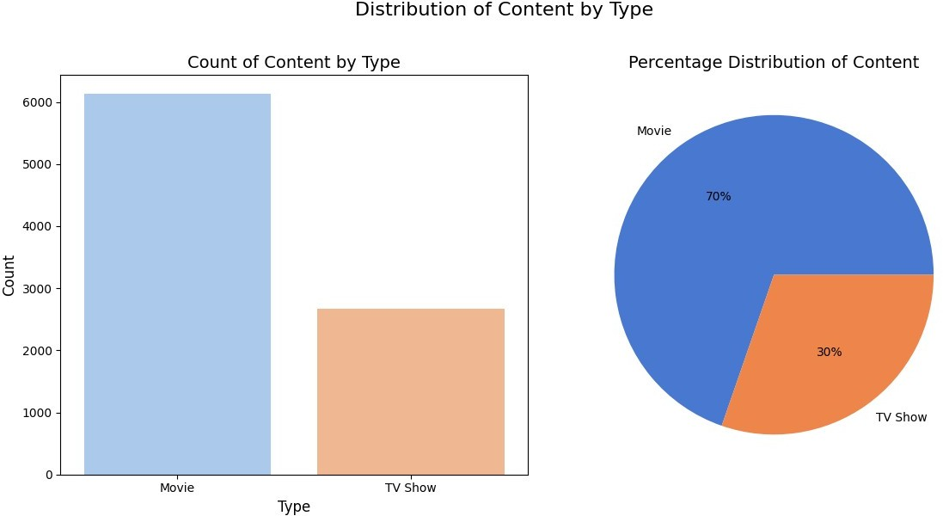
Observation-
Using the dataset, we calculated the proportions of each content type. The analysis shows that: Movies dominate the platform, making up 70% of all titles.TV Shows account for the remaining 30%.
Rating on Netflix-
ratings=DF['rating'].value_counts().reset_index().sort_values(by='coun t', ascending=False)
rating_counts = DF['rating'].value_counts() plt.pie(ratings['count'][:8], labels=ratings['rating'][:8], autopct='%.0f%%')
plt.suptitle('Rating on Netflix', fontsize=20)
Text(0.5, 0.98, 'Rating on Netflix')

Slide 30
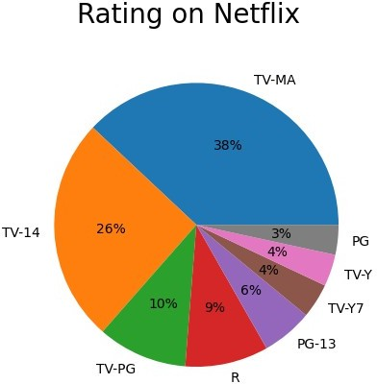
Observations-
Overall Distribution: TV-MA leads the ratings, making up a significant portion of Netflix’s catalog. TV-14 and TV-PG follow, showing that Netflix appeals to a wide audience but primarily targets mature viewers.
Ratings by Type: Movies tend to have a broader range of ratings, including R and PG-13, reflecting traditional film ratings. TV Shows are dominated by TV-MA and TV-14, highlighting a focus on episodic content for adults and teens.
Top 10 Movie Genres-
popular_movie_genre=DF[DF['type']=='Movie'].groupby("listed_in").size(
).sort_values(ascending=False)[:10] popular_series_genre=DF[DF['type']=='TV Show'].groupby("listed_in").size().sort_values(ascending=False)[:10]
plt.bar(popular_movie_genre.index, popular_movie_genre.values,color='purple') plt.xticks(rotation=45, ha='right')
plt.xlabel("Genres")
plt.ylabel("Movies Frequency")
plt.suptitle("Top 10 popular genres for movies on Netflix")
plt.show()

Slide 31
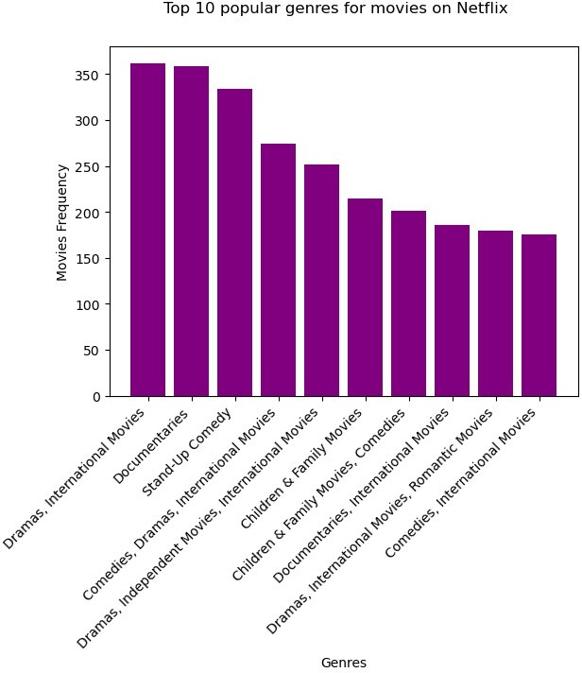
Observation-
The most frequently occurring genres on Netflix are: International Movies Dramas Comedies International TV Shows Documentaries

Slide 32
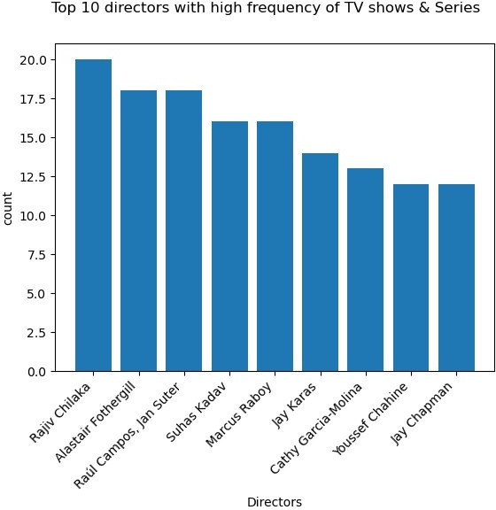
Top 10 directors with high frequency of TV shows & Series
directors=DF['director'].value_counts().reset_index().sort_values(by=' count', ascending=False)[1:10]
plt.bar(directors['director'], directors['count']) plt.xticks(rotation=45, ha='right’)
plt.xlabel("Directors")
plt.ylabel("count")
plt.suptitle("Top 10 directors with high frequency of TV shows & Series ")
plt.show()

Slide 33
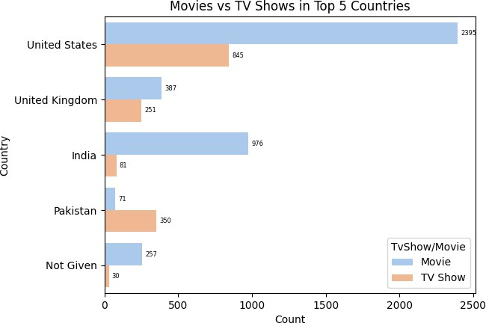
Movies vs TV Shows in Top 5 Countries
top_countries = DF['country'].value_counts().head(5).index filtered_df =DF[DF['country'].isin(top_countries)]
ax=sns.countplot(y='country', hue='type', data=filtered_df, palette='pastel')
# Add value annotations
for container in ax.containers:
ax.bar_label(container, label_type='edge', fontsize=6, padding=3)
plt.title('Movies vs TV Shows in Top 5 Countries')
plt.xlabel('Count')
plt.ylabel('Country') plt.legend(title='TvShow/Movie')
plt.show()
Observation-
The dataset reveals that the following directors have the highest number of productions available on Netflix:
Rajiv Chilaka,Alastair Fothergill,Raul campos,jansuter etc.

Slide 34
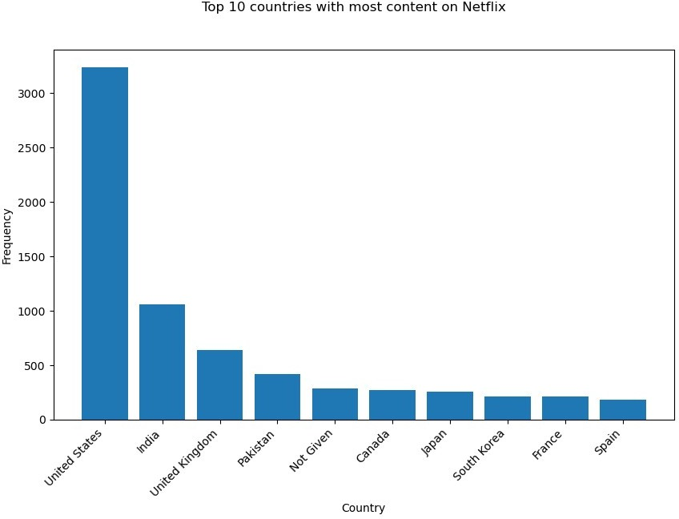
Top 10 countries with most content on Netflix
top_five_countries=DF['country'].value_counts().reset_index().sort_val ues(by='count', ascending=False)[:10]
plt.figure(figsize=(10, 6))
plt.bar(top_five_countries['country'], top_five_countries['count']) plt.xticks(rotation=45, ha='right')
plt.xlabel("Country") plt.ylabel("Frequency")
plt.suptitle("Top 10 countries with most content on Netflix")
plt.show()
Observation-
From above graph we can analyse that United Staes,United Kingdom,India and pakistan are top countries where most of the movies and TV shows watched on netfilix.

Slide 35
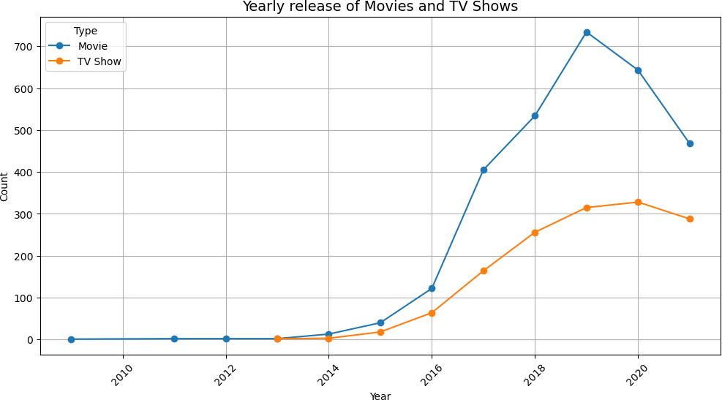
Yearly release of Movies and TV Shows
# Plot content added over the years using a line chart
DF['year']=DF['date_added'].dt.year plt.figure(figsize=(12, 6))
DF.groupby(['year', 'type']).size().unstack().plot(kind='line', marker='o', ax=plt.gca())
plt.title('Yearly release of Movies and TV Shows',fontsize=14) plt.xlabel('Year')
plt.ylabel('Count')
plt.xticks(rotation=45) plt.legend(title='Type') plt.grid(True) plt.show()
observations–
After 2016 the movies and TV shows release goes on increasing.
-

Slide 36
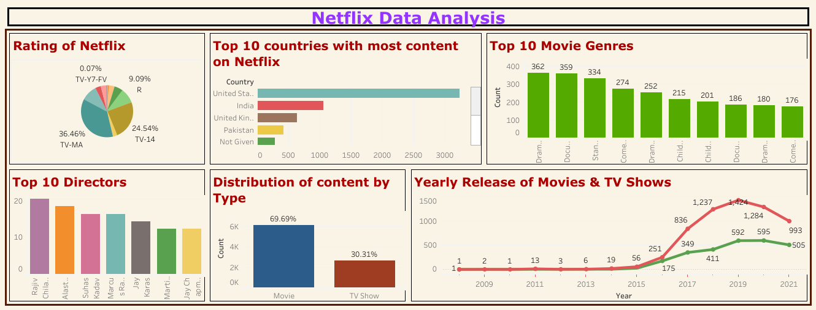
Dashboard

Slide 37
Insights-
1.Movies dominate the platform, making up 70% of all titles.TV Shows account for the remaining 30%.
2.Netflix's catalog primarily targets mature audiences, as shown by the dominance of TV-MA. However, the platform maintains a diverse library, ensuring that viewers of all age groups can find suitable content. Regional content ratings, such as NR (Not Rated), could benefit from further exploration to understand their implications for global markets.
3.The most frequently occurring genres on Netflix are: International Movies Dramas Comedies International TV Shows Documentaries. The popularity of International Movies and TV Shows underscores Netflix's focus on expanding its global audience.
4.The highest number of productions available on Netflix:Rajiv Chilaka,Alastair Fothergill,Raul campos,jansuter etc.
5.United Staes,United Kingdom,India and pakistan are top countries where most of the movies and TV shows watched on netfilix.
6.Ratings by Type: Movies tend to have a broader range of ratings, including R and PG-13, reflecting traditional film ratings. TV Shows are dominated by TV-MA and TV-14, highlighting a focus on episodic content for adults and teens.

Slide 38
Recommendations- 1.Invest more in International Movies and TV Shows, as these genres are already popular and drive global audience engagement. Explore regional content ratings like NR (Not Rated) to better cater to diverse markets and improve accessibility for different regions. 2.While the current focus on mature audiences (TV-MA) is evident, there is an opportunity to expand the library with more family-friendly and children-oriented content to capture a broader audience base. 3.Prioritize content marketing efforts in countries like the United States, United Kingdom, India, and Pakistan, as these are the top-performing markets. Offer localized content with subtitles and dubs to further engage audiences in these regions. 4.Collaborate further with high-performing contributors like Rajiv Chilaka, Alastair Fothergill, Raul Campos, and Jan Suter to produce more content under their expertise. This could attract loyal fans and increase viewership. 5.Focus on expanding the catalog of trending genres like Dramas, Comedies, and Documentaries to maintain user engagement. Conduct periodic analysis of emerging genres to adapt to audience preferences quickly. 6.Tailor personalized recommendations based on viewing patterns of popular genres and regions to boost user satisfaction and retention. 7.Establish more production hubs in key regions like India and Pakistan to create cost-effective and locally relevant content. 8.Introduce TV Shows with a wider range of content ratings (e.g., TV-Y, TV-PG) to balance the dominance of TV-MA and TV-14 shows.

